Slide 1
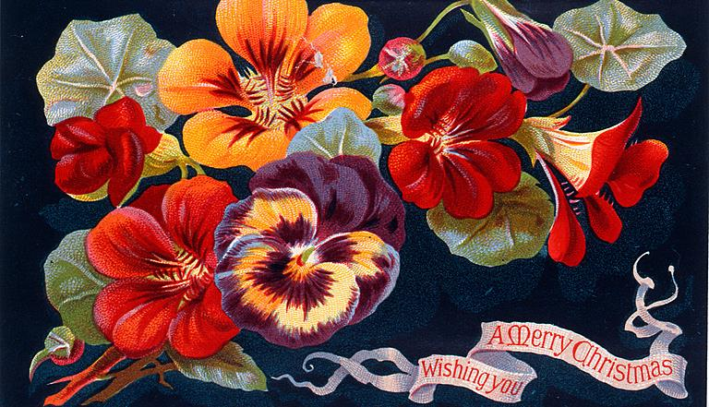
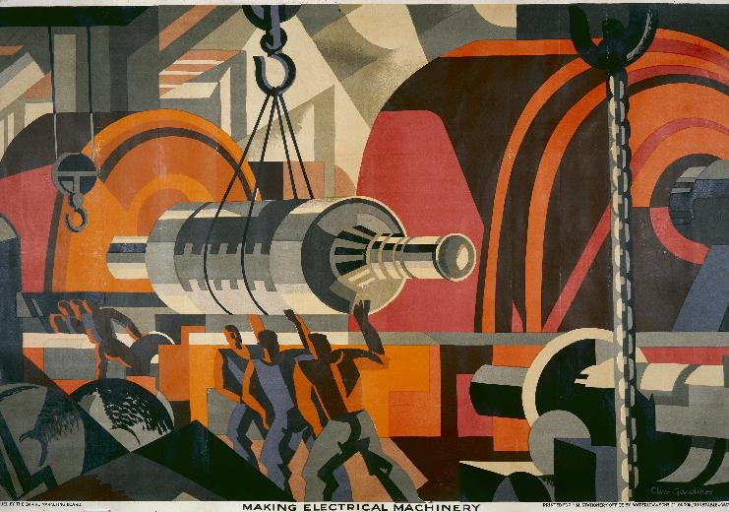

Further Adventures in Topic Modelling
24 July 2024
Notes:
Its still topic models
I think maybe we are going to end up looking at topic modelling a lot
Within the time available, its tricky to switch to a different technique
Perhaps its a good thing to stick with one method
Or perhaps not, that’s something we could discuss

Slide 2
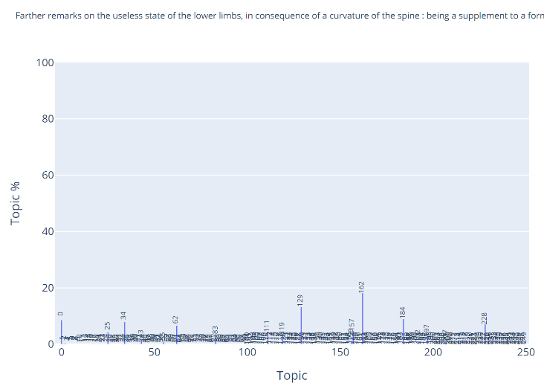
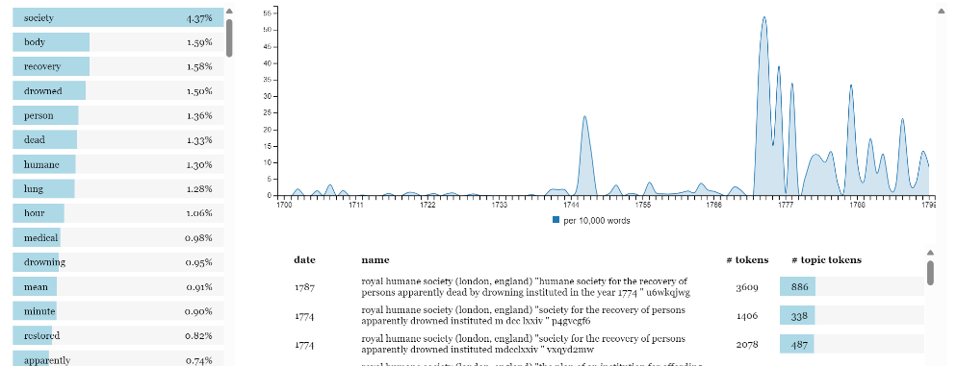
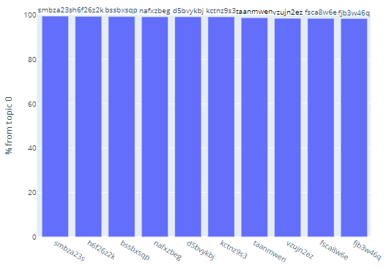
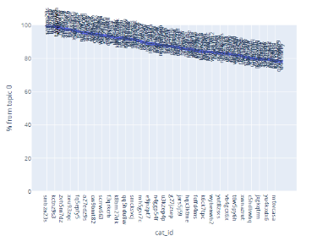
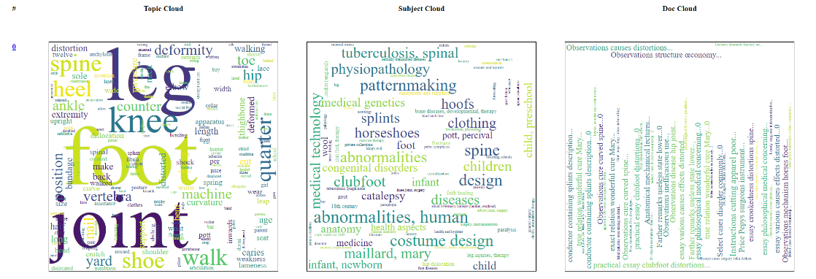
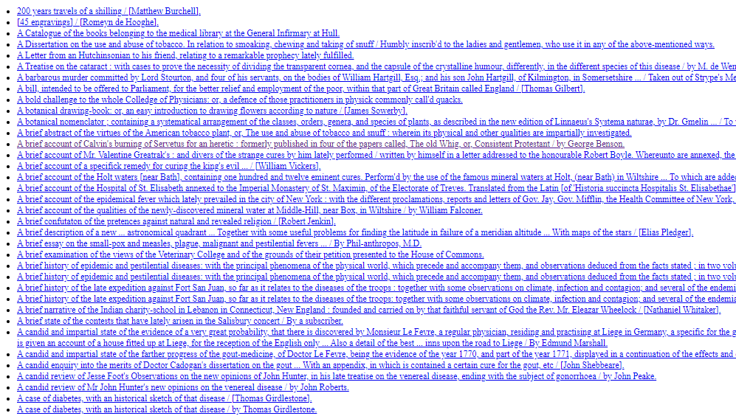


What have I done?
Notes:
Last time I showed you HaToRI
A tool to study Hansard through a topic model lens
Which I had repurposed to look at 18th century texts listed in the catalogue
For this time, I’ve tried to go beyond that interface a bit
And find a few other ways to look at the collection through a topic model view
Including bringing in some information from the catalogue
And working with different model counts
So now I have 10, 50, 100, 250 and 500 topic views of the collection
Coarser and finer grained views of the collection
In terms of what I can show you, feels a bit like stepping backwards to go forwards
Kind of a hodge podge of views, maybe a bit of a shotgun approach
Which I’ve bodged together into a very Web 1.0 kind of a thing

Slide 3
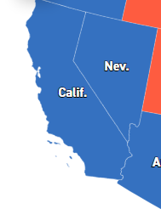
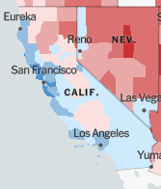
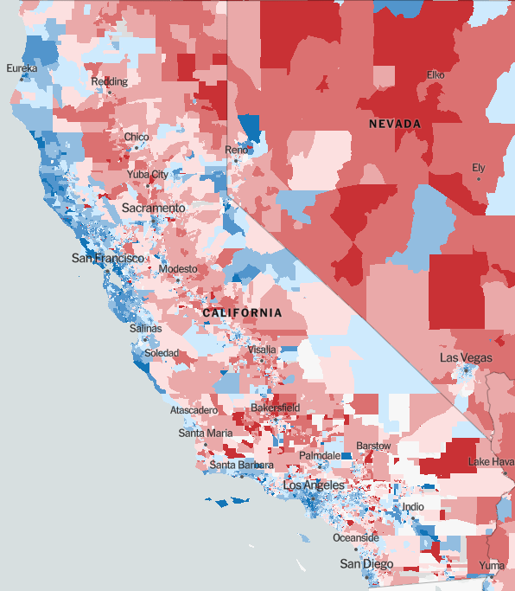
Granularity
Presidential Election Results 2020 | Live Map Updates | State Electoral Votes (politico.com)
An Extremely Detailed Map of the 2020 Election Results: Trump vs. Biden - The New York Times (nytimes.com)
Notes:
By granularity here I’m talking about the number of topics
We can think of a small number of topics as giving us a distant view of main themes in the collection
And a larger number as giving us a closer, more detailed, granular view
I’ve tried to illustrate that by analogy here, with this 2020 US election map
From a distance we see that California and Nevada voted Democrat.
A closer, more granular view shows large blue and red chunks
And eventually a fine-grain view of the vote by individual “units”
Similarly, a 500 topic view like the one I brought last time gives a reasonably fine-grained view of the corpus
A 10 topic view gives a very coarse-grained view
And other topic counts sit in the space in-between
For a relatively specific search like “material relevant to aging”, we would probably want the more granular models
I haven’t counted the number of unique subjects covering your 18th century documents, it might be an interesting point of comparison

Slide 4

Word clouds galore
Notes:
I may have got a bit carried away with word clouds
That’s partly efficiency – having learned how to make them, its easy to stick with them
I do also just like them in some respects, I think they’re quite an intuitive way to show the relative importance of things
But of course they are not perfect for everything
One thing I’d like to consider a bit today is “ways of representing things”
So what you see here is a topic represented in 3 clouds:
Clouds like before, showing the relative importance of words making up the topic
A subject cloud, showing the relative importance of catalogue subjects in the topic
A document cloud, showing the most important documents to the topic
I think I’ve got these clouds showing less important entries than in HaToRI, ie the stuff in very small text
It may well be that these should be ignored as being below the threshold of significance

Slide 5
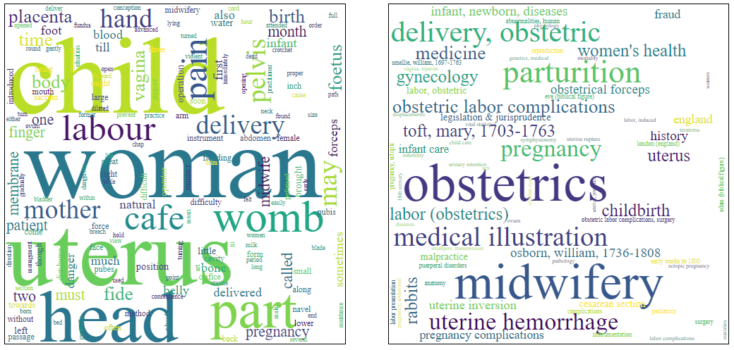
What makes a model: subjects
Notes:
So here you see a topic on the left, and its “subject cloud” on the right
I believe that what I am showing you here are what are called “concepts” in works.json
The size of the subject should be in proportion to the importance of that subject in the topic
i.e. the amount that subject shows up in books related to the topic
scaled for the importance of those books
The colours do not mean anything, they just make it a bit easier to see multi-word subjects
I actually find them slightly nauseating, but they do make it a bit easier to read
Subjects are also hyperlinks into the catalogue
They will do a search for that subject label in the catalogue
(Not all of the labels work as a catalogue search, I guess probably there’s a way to look based on the ID instead? But it might come down to the different domains of subjects involved.)
As implemented I actually don’t find this helpful for understanding the topic
But it is helpful for using the subject cloud as a jumping off point for exploring the catalogue, which is kind of a different use case
Also get a word search for free, in that these images are SVGs, so the text is embedded in them and searchable by normal browser search
I do feel like the subjects often “make sense” as a cluster, which is encouraging from a “do these topics point to something meaningful” point of view... though it would be nice if the topics themselves felt more meaningful. This one is case where both the topic and the subject cloud seem to indicate something to do with childbirth.

Slide 6
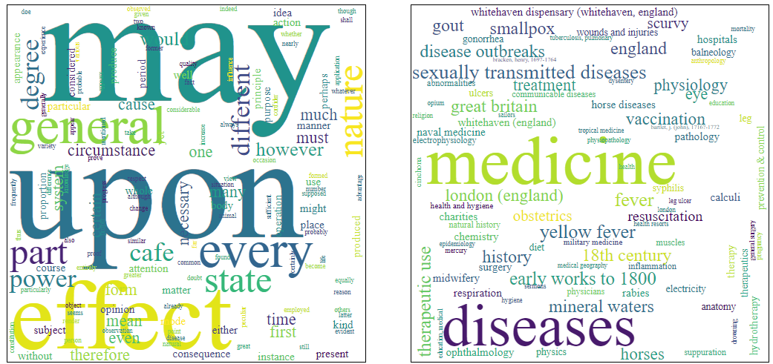
A less promising subject cloud
Notes:
They’re not all like that
Here is one where the clouds are less clear
The subject cloud seems more or less to be about disease (but has some other things sprinkled in)
The topic cloud seems largely meaningless
But on the whole, the subject clouds seem to make sense
Based on the very limited amount of browsing I’ve been able to do
That said, I believe humans are good at seeing sense and structure in randomness
And word clouds do seem to invite cherry-picking of apparently related terms
The risk of this may be increased, as I’m showing more of the less-related terms than did the previous clouds
So, as ever, caution

Slide 7
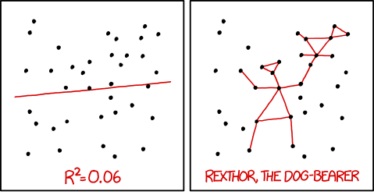
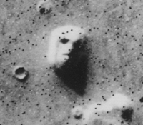
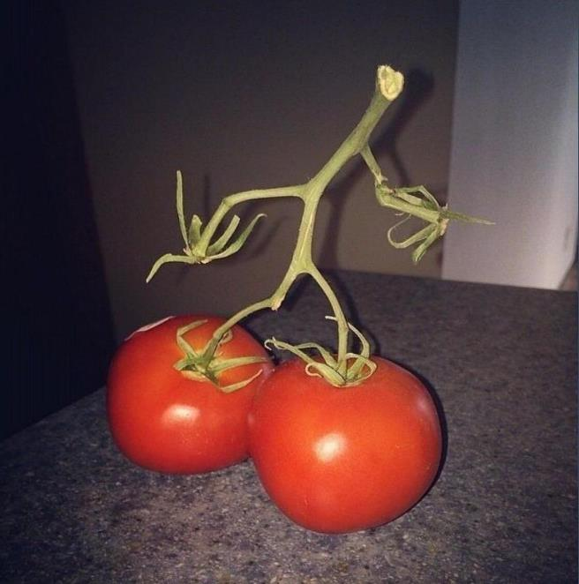

False/Dubious Sense
https://en.wikipedia.org/wiki/File:Martian_face_viking_cropped.jpg
https://forums.forteana.org/index.php?threads/pareidolia.55195/post-1787443
https://forums.forteana.org/index.php?attachments/g6gqjez6q9o11-jpg.11890/
Notes:
Here we have the face on Mars and a sneaky person in big boots
And then a more data perspective from a webcomic (XKCD), including:
You can use maths to tell yourself stories about data by fitting different kinds of line
Or you might, for example, see Rexthor the Dog-Bearer in a random pattern of dots

Slide 8
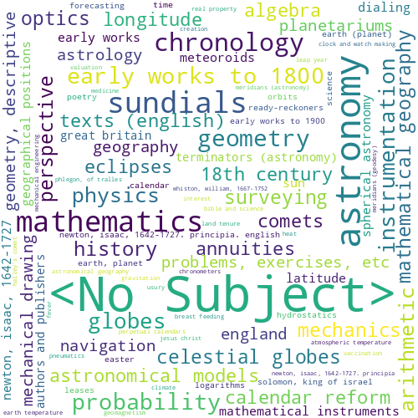
Identifying missing subjects
Notes:
Not everything has a “concept”.
I did try making that visible in the clouds with a “<no subject>” entry
But that entry often dominated the cloud, which made me worry that the proportions of everything else might be getting thrown off
Which I guess is just an example of the difficulty of representing things “truthfully” or “honestly”, but also “usefully” (which is an approximation tradeoffs in catalogue description have been described to me by a colleague)
I don’t think there were *that* many missing subjects, so I’m a bit curious that it shows up so big... could be a sign of a bug, could be something real
I guess there just have to be more “no subjects” than any other single subject for this to be likely to happen
(It turned out that there were 1968 docs with no subject – which is a large proportion of 4852 but didn’t surprise the participants.)

Slide 9
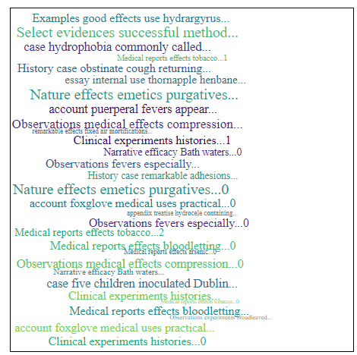
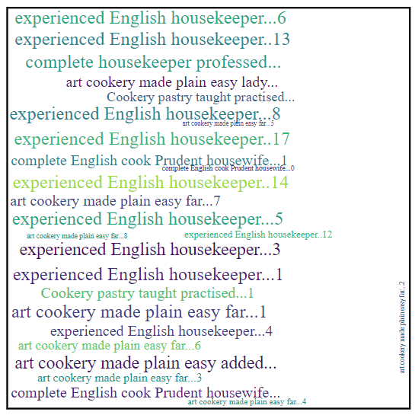
What makes a model: documents
Notes:
This is where I feel like clouds stop being helpful
Following the same principle as subjects, but for the documents contributing to the cloud
For one thing, titles are really too long for a cloud
I’ve removed stopwords from them, and cut them off after so many characters
But that only helps so much
I find it is harder to take this in as a cloud
And for whatever reason, these clouds don’t tend to show a few dominant texts
So they’re not much help for picking out the most important ones
Perhaps this tells us that topics tends to have a lot of broadly similar contributions
One thing it does sometimes highlight is that a topic is drawing from multiple copies of the same text
The one on the right seems quite dominated by different copies of a couple of books
But generally, Hatori’s listing of titles seemed more useful
I thought a little bit (not much) about why this might be
A title is a lot to take in compared to a word or short phrase
Especially an 18th century title, even abbreviated
The lack of differentiation in size means you need to look at the whole thing
Long things are just hard to fit into a word cloud, geometry-wise
I wonder if there might be other reasons why a semi-random collection of titles would not necessarily point towards a specific subject

Slide 10
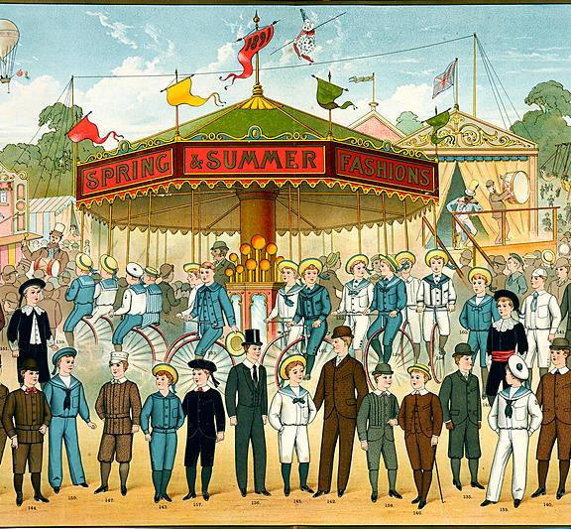
Exercise: The Eighteenth Century in Ten Subjects
Notes:
It’s difficult to show all 10 subjects at once on the screen, so here’s a handout – or you can go to the website.
There’s also a Padlet with some questions on. You’re welcome to write thoughts on it, I’ll try to capture some discussion points there.

Slide 11
Examples
Notes:
These are a few observations from wandering around the interface myself
I think they’re all from the 50 topic view

Slide 12
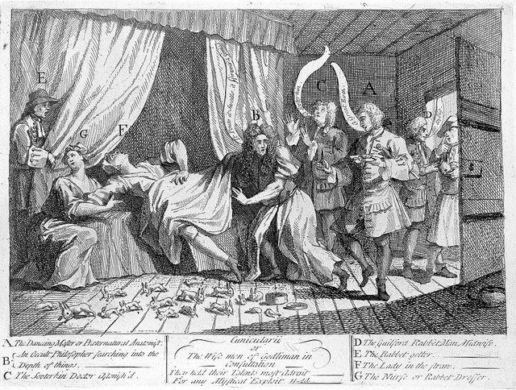
Mary Toft
Mary Toft (Tofts) appearing to give birth to rabbits in the presence of several surgeons and man-midwives sent from London to examine her. Etching by W. Hogarth, 1726. Wellcome Collection. Source: Wellcome Collection.
Notes:
Just browsing around these pages while putting this thing together, Mary Toft jumped out at me a lot
I guess you may well all know her already, but just in case:
Supposedly gave birth to rabbits
Supported by a local surgeon
Examined by others, I think brought to London and examined by the King’s surgeon?
Eventually confessed to a hoax
In one “50 topics” view, she is in 17 of 50 topics
Prominently in 5, so in 1/10th of the topics
Is she over-represented? I guess I might just be noticing her because I happened to have heard of her
Clicking on the subject link gets only 40 results – but 27 of them are online books, which perhaps is a lot of representation on a quite specific subject
I don’t know what that means, don’t know whether her representation is reasonable.
What I did find when I looked at the clouds was that the subject cloud sometimes made more sense than the topic cloud e.g.
topic 6 sees to be about science
topic 38 seems to be about trials, law
Top 10s:
Topic 6: Nearly all about microscopes... nothing obviously about Toft
Topic 12: A couple of cases in the top 10 – but only at around the 40% contribution level
Topic 36: 1 case – in a book which makes moderate contributions to many topics
Topic 37: 3 Tofts?
Topic 38: Not obviously about Toft
Just looking at this one highlights some shortcomings in the interface, e.g.
Just a list of top titles would be helpful
Listing titles with subjects would be helpful (not necessarily obvious from the title that a book is relevant to Toft)

Slide 13
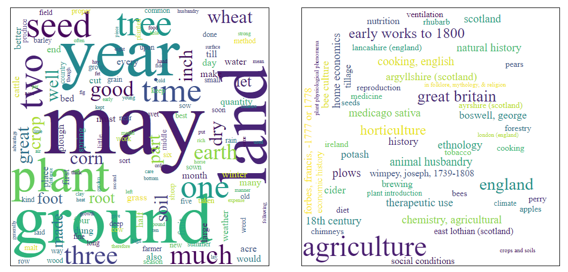
Serendipitous Discovery
Notes:
Perhaps there is just something about seeing the collection through another lens that can spark ideas
Seeing subjects that the models bring together show me things that are in the collection that I might not have thought of
For example, I hadn’t particularly thought of Wellcome as a place to look for works on agriculture (or horses) until I started topic modelling it
Or I just spot interesting or surprising subjects while glancing at a subject cloud (for example, “Jesus Christ”, or “horses”, or murder/homicide trials.
So perhaps this has some use for exploring the collection as an outsider

Slide 14
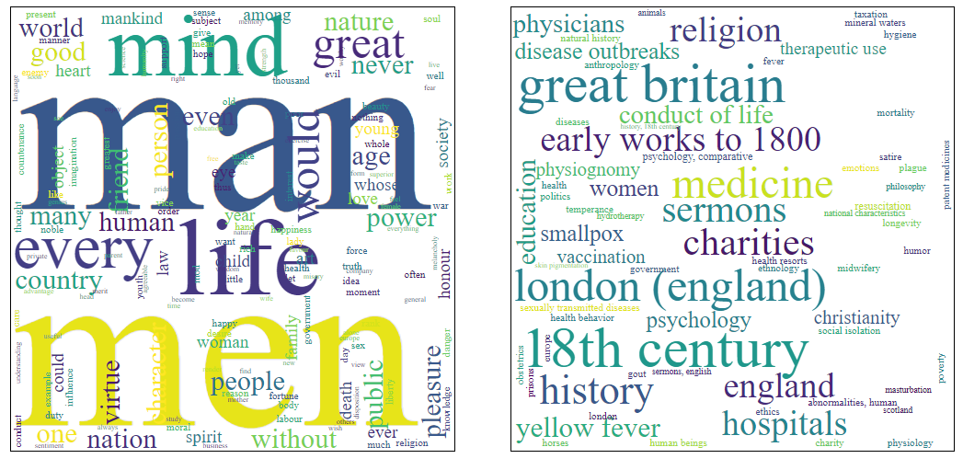
Serendipitous Juxtaposition
Notes:
Or seeing subjects connected together might encourage me to explore that apparent connection
This one perhaps points to exploring the relationship between medicine and religion (and perhaps looking for that in relation to specific diseases or themes, such as vaccination)
I’m sort of interested in the gigantic man/men in the topic cloud, too – perhaps here more in the sense of mankind than gender-specific?

Slide 15
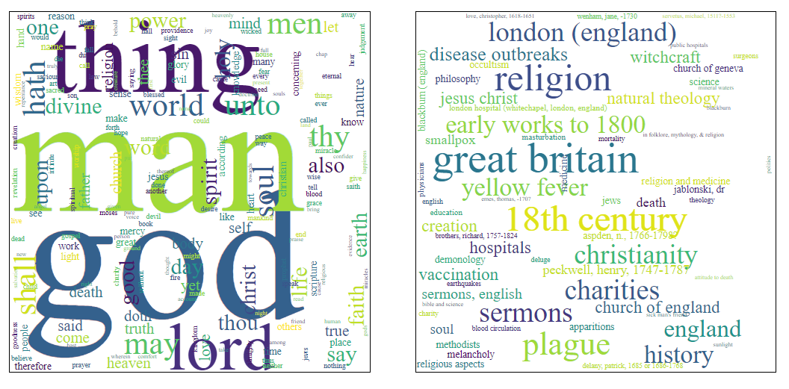
A similar serendipitous juxtaposition
Notes:
Just threw this one in because it was nearby and is kind of similar, but here the topic seems more clearly religious

Slide 16
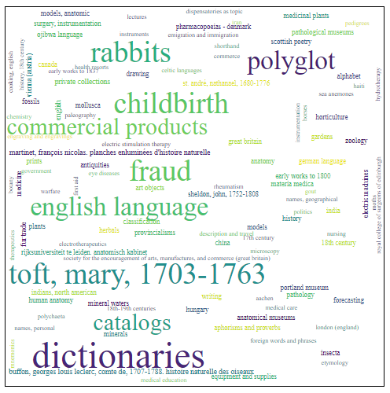
Hallucinations?
Notes:
But apparent connections can always be hallucinatory, of course
e.g. I could read this as connection Mary Toft/Childbirth on the one hand, and language/dictionaries on the other
But I am sceptical that these are related things

Slide 17
Other Views

Slide 18
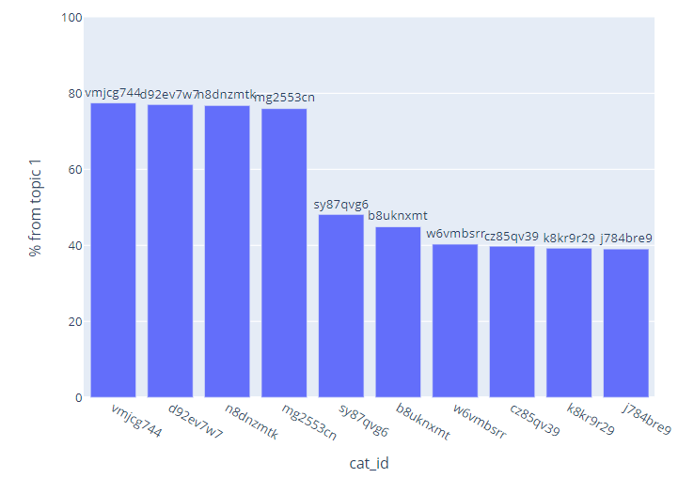
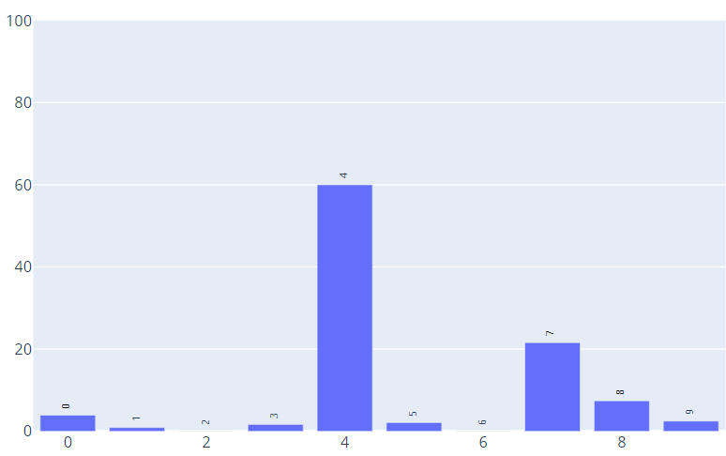
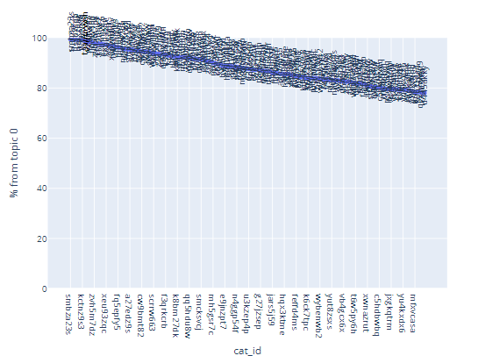
Some Other Views
Notes:
I also just had time to generate a few other charts
Of which I think only the one on the left is really useful

Slide 19
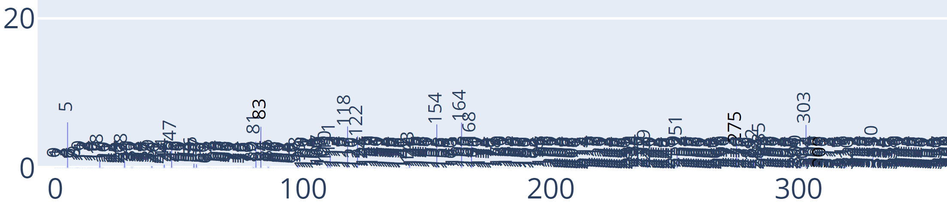
Document Topics
Notes:
This bar graph shows which topics the book is important in
You can get to these by clicking on a title in the word cloud
Or by picking it out of a list of all of the documents
Unlike the word clouds, this kind of representation looks very different at different scales
A word cloud for a 10-topic view of the collection looks much the same as in a 500 topic view
Here, at the top, we have the 10-topic-view bar graph for “A practical essay on the use and abuse of warm bathing in gouty cases” (A practical essay on the use and abuse of warm bathing in gouty cases / By William Oliver. | Wellcome Collection)
And at the bottom, the same book in a 500 topic view – zoomed in a lot
So in the 10 topic view, we can immediately see that this book is important in topic 4, and to some extent in topic 7
The bottom view is horrifyingly crowded, but we can see that some topics stick up above the mass
Sometimes there are a couple that stick way up above, which is more interesting
Obviously this can be improved, but there’s always going to be more to take in with 500 topics
The intent is that we can use books as a way of linking topics together
Discovering related books through related topics
Though it is not the easiest process with this basic interface

Slide 20
Top 10 documents
Notes:
Then there are a couple of other bar chart views, these ones of the document makeup of topics
I’ll try to go through these quickly as I think they are less helpful
This one shows the 10 most important documents to a particular topic
We can see that 4 are highly important, with a drop to the next 6
Maybe useful for identifying the most important documents in this topic
As a route into the Document Topics view that I just showed you

Slide 21
“> 40%” Documents
Notes:
I think this is the least useful graph, I’m just showing you for completeness
It shows all documents with a >40% contribution
Or the top 150 documents if there are more than that
Mostly to stop the graph generation taking too long
But also because more dense graphs can be hard to read
This one must have been cut off at 150
But I’m not sure that it’s any use at all!
It might have value for understanding the models in some sense, but not in a direction that feels fruitful for this project
It’ll also get emptier for larger topic counts, as the chance of large contributions from a single document drop off

Slide 22
Demo & Exercise
Notes:
So now I’ll demonstrate a quick wander around this interface, looking for material about age
[Demo]

Slide 23

Exercise: Effective Sensemaking
Compare topic granularities
Compare topics that share particular documents
Follow a path starting from some document of interest
Focus on subject clouds
Or on document clouds
Fine-grained views
may stress your computer
Notes:
So what I’ve tried to do is to add a few ways to try to make topic models a bit more meaningful
And to integrate a bit of information from the catalogue
But mostly just by making it easy to link to the catalogue
I’m sure something more, and more sensemaking tools, would work better
An improved version of the graph view in HaToRI might be one example
So what I would like you to do now is:
Spend some time exploring this interface
It might help to focus on one thing, some suggestions on slide
Think about:
How would you use this? (Or rather, a more fully developed version of something like this)
What would it be helpful for?
What would it be unhelpful for?
And then discuss:
What else from the catalogue would help this tool
What other visualisations would be helpful?
What might an effective interface look like?
Examples of things that might help with search:
Ability to see the specific parts of a text that contributed to the topic
Ability to find related topics

Slide 24
Thank you
Bernard Ogden
The National Archives
Kew, Richmond
TW9 4DU

